Slide 1
Proactive Calling of VA Subjects For Research Recruitment
Dial in: 1 – 404 – 397 – 1596
Access Code: 199 763 4589
Slides in “Handout” Tab
Molly Klote, MD
C. Karen Jeans, PhD, CCRN
Office of Research Protections, Policy, and Education August 24, 2021

Slide 2
Objectives
The learner will be able to:
Describe what is meant by the term “proactive calling”.
Explain the rationale for the change regarding the limited use of proactive calling for recruiting VA subjects in VA research.
List examples of acceptable means to contact potential VA subjects for recruitment in VA research.
Identify what types of VA studies could apply for ORD approval to proactively call VA subjects for recruitment.
Describe the process for submission and evaluation of requests submitted for ORD approval to proactively call VA subjects for recruitment.

Slide 3
Definitions
Research recruitment: Involves a number of activities, including identifying eligible subjects, adequately explaining the study to the potential subjects, obtaining informed consent, and retaining subjects until study completion.
Recruitment materials: Fliers, information sheets, mail (hardcopy or electronic), postcards, and/or telephone scripts describing the specific requirements and conditions to participate in a research study. For non-exempt research, these materials must be approved by an Institutional Review Board (IRB).
Proactive Calling: Contacting a potential VA subject by telephone for the purpose of initial research recruitment without prior contact (letter, email, clinical encounter) regarding the study.

Slide 4
Current ORD Policy: VHA Directive 1200.05
VHA Directive 1200.05, Paragraph 5(g)(8) states that each VA Investigator is responsible for the following:
“(8) During the recruitment process, making initial contact with potential subjects in person or by letter prior to initiating any telephone contact, unless there is written documentation that the subject is willing to be contacted by telephone about the study in question or a specific kind of research as outlined in the study.“
Letter: Refers to hardcopy or electronic

Slide 5
Current ORD Policy: VHA Directive 1200.05: Notes
NOTE: If existing information from sources such as a medical record or database (research or non-research) are used to identify human subjects, there must be an IRB-approved waiver of HIPAA authorization for this activity in the new protocol;
(a) Any initial contact by letter or telephone must provide a telephone number or other means that the potential subject can use to verify that the study constitutes VA research;
(b) If a contractor makes the initial contact by letter, the VA investigator must sign the letter;
NOTE: This section does not apply when a Veteran calls in response to an advertisement;”
Reference: VHA Directive 1200.05, Paragraph 5(g)(8)

Slide 6
Why was the ORD Policy on Use of Telephone Calls for Subject Recruitment Issued?

Slide 7
Background
The VA was hit by a massive data breach on May 3, 2006 when a laptop PC and external hard disk containing personal data (names, Social Security Numbers, and birth dates) on a reported 26.5 million Veterans and active-duty military personnel were stolen from the home of a VA employee.
In the past, fraudsters have used events similar to the data breach to scam people into divulging their personal information by e-mail and over the phone.
This Photo by Unknown Author is licensed under CC BY-SA

Slide 8
Action Taken by VHA from 2006 Data Breach
Memorandum, “Researcher Contacts with Veterans,” issued on July 10, 2006 from the Principal Deputy Under Secretary of Health and Chief Research and Development Officer (CRADO)
The Memorandum Informed the VHA research community that researchers’ initial contact with Veterans for purposes of study recruitment would be made in person or via letter rather than by telephone (“cold calling”).
ORD policy put in place in VHA Handbook 1200.05 (and its replacement VHA Directive 1200.05) reflecting the requirements of the July 10, 2006 Memorandum.

Slide 9
Examples of Methods to Contact VA Subjects for Recruitment (with IRB approval)
Advertise within the medical centers,
Communication to providers
Fliers, trifolds, pocket cards
Recruitment tables/events
Internal medical center communication media (screens)
Brief to chiefs of staff at VHA level meetings for multi-site studies
Place advertisements on VA authorized social media, Craigslist, hard copy media
Send mail (hardcopy or electronic)

Slide 10
Historically the most usual means of recruitment: In Facility Contact
Recruitment materials physically posted at the facility
Discussion of a study by a non-study team member provider who is seeing the potential subject during a scheduled clinical appointment
Discussion with a study team member at a recruitment table/event

Slide 11
Then the pandemic hit….
This Photo by Unknown Author is licensed under CC BY-NC-ND
This Photo by Unknown Author is licensed under CC BY

Slide 12
Pandemic Study Recruitment Slowdown
Studies were affected in terms of ability of researchers to be in the medical facilities for non-critical study interactions
Electronic consent procedures were instituted
iMedConsent
Photographing signed and dated consent forms/authorizations
DocuSign
Other mitigating activities
Letters to potential subjects (after IRB approval with approval of waiver of HIPAA authorization)
Telehealth appointments by providers
Volunteer Registry

Slide 13
COVID-19 Pandemic Unmasked an Issue Requiring Re-Evaluation
There are certain situations where the ability to proactively call VA subjects for study recruitment is appropriate.
A letter, email, or clinical encounter cannot occur in a timely enough manner to meet the inclusion requirements of the study.
Adequate measures are put in place to protect subjects’ privacy and ethical rights.
The study’s potential impact on life-saving therapies warrant proactive calling (e.g., a disease outbreak, pandemic, etc.).

Slide 14
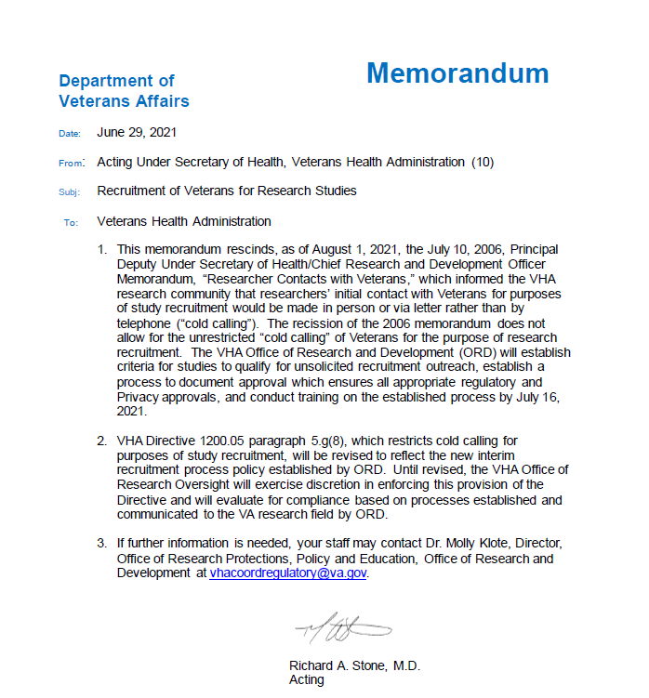
Policy Change
The acting Under Secretary of Health (USH) signed a policy memorandum on June 29, 2021 allowing for the proactive calling of VA subjects for recruitment only within the parameters that ORD establishes for an ORD approval process.

Slide 15
June 29, 2021 USH Memorandum: “Recruitment of Veterans for Research Studies”
Rescinds, as of August 1, 2021, the July 10, 2006, Principal Deputy Under Secretary of Health/Chief Research and Development Officer Memorandum, “Researcher Contacts with Veterans”.
Does not allow for the unrestricted “cold calling” of Veterans for the purpose of research recruitment.
Requires ORD to establish criteria for studies to qualify for unsolicited recruitment outreach and establish a process to document approval which ensures all appropriate regulatory and Privacy approvals.
States that the Office of Research Oversight (ORO) will exercise discretion in enforcing ORD policy in VHA Directive 1200.05, Paragraph 5.(g)(8) based on processes established and communicated to the VA research field by ORD until VHA Directive 1200.05 is revised.

Slide 16
Is it Safer to Call VA Subjects Now?

Slide 17
Rise in Unsolicited Calls
Since 2006, (15 years later) unsolicited telephone calls across the United States have risen dramatically, and, in some cases, it is estimated that 50% of all calls on some phone lines are unsolicited.
Sophistication of the methods used by fraudsters have increased with advancing technology.
Measures will be put in place by ORD to protect the privacy of VA subjects and ensure ethical protections are in place for studies approved for proactive calling for recruitment.

Slide 18
Rise in Telehealth
Veterans are receiving an increasing number of telehealth encounters compared to the pre-pandemic period. Telehealth ramped up, connecting providers and patients (VAntage Point) with more than 7 million encounters in 2020 alone.
Telephone encounters by clinical providers (without video) are also considered a form of telehealth.

Slide 19
Rise in the Use of Email Communications
The VHA has had a marked increase in the use of email to Veterans through platforms like MyHealtheVet.
MyHealtheVet cannot be used to send emails for purposes of study recruitment.
Email can be used to recruit prospective VA subjects and to communicate with VA subjects who have consented to participate in a VA research study as described in the IRB-approved research study.
Personal email accounts (e.g., Google) or university email accounts cannot be used for research communications with prospective or consented VA subjects.
No PII/PHI can be sent by a VA Investigator for VA research purposes to a prospective or consented VA subject by email unless the email is encrypted using a VA approved encryption method (e.g., Azure Rights Management System).

Slide 20
How does Proactive Calling Work?

Slide 21
Important Considerations Prior to Applying to ORD for Proactive Calling for Recruitment
The number of studies expected to obtain ORD approval for proactive calling for subject recruitment will be small and is not analogous to the DocuSign approval process.
Do not apply for approval when a VA subject has documented his/her permission for research contact through another research protocol and the research team asking for the information has appropriate privacy approvals.
Limited to what was consented/HIPAA Authorization, such as permission granted to be contacted for future oncology studies

Slide 22
Important Considerations Prior to Applying to ORD for Proactive Calling for Recruitment (cont.)
The term “in-person” for the purpose of initial contact for a VA conducted research study now includes contact during a VA clinical telehealth video or clinical telephone encounter.
Evaluate whether other methods of subject recruitment can be utilized.

Slide 23
ORD Request Process for Proactive Calling for Subject Recruitment
A request must be submitted and approved through the described ORD process using the designated ORD SharePoint Site.
ORD approval should be obtained prior to IRB submission.
ORD approvals are specific to the individual research study submitted with the request.
A request may be submitted for an individual subject (not all subjects) if the criteria are met.

Slide 24
ORD Criteria to Apply for Approval
The research must be a non-exempt study.
The research must involve potentially life-saving treatments for a serious disease or condition.
The research must have a short time window (< 96 hours needed to enroll to qualify).
The application must include justification of why proactive calling must be used instead of using in-person or mail notifications as the initial contact.
The research must describe a verification process for how the serious disease or condition is verified prior to proactively calling the potential subject.

Slide 25
ORD Criteria to Apply for Approval (cont.)
The research must describe:
how the potential subject’s primary clinical care team will be contacted prior to the proactive call for study recruitment, or
a justification of why the primary clinical care team will not be contacted until after the potential subject has received a proactive call for study recruitment.
The application must include:
a plan to ensure that the calls made by the VA study team are from a non-blocked, VHA number,
a copy of the script used for contacting the subject, and
the number of calls to be made for each potential subject.

Slide 26
ORD Criteria to Apply for Approval (cont.)
The application must describe how the telephone numbers will be obtained (e.g., source).
If the study proposes to leave a message on the potential subject’s phone,
a script of the proposed message must be submitted with the application, and
a plan of steps to be taken to ensure that any message does not include Protected Health Information.

Slide 27
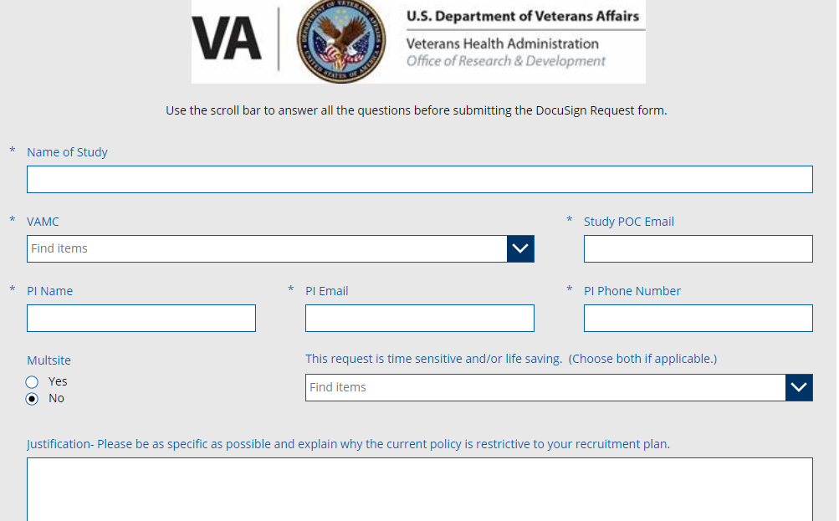
ORD Proactive Calling SharePoint Site
A SharePoint site will be established to receive requests
Justification will be required based on the information discussed in this presentation and on published FAQs/Guidance document.
Example: not actual site

Slide 28
Oversight Committee Approval Required
ORD approval is not the final approval.
The IRB will:
Evaluate if this type of contact is appropriate within the context of the given study to ensure that appropriate safeguards exist to protect the rights and welfare of research subjects
Approve the details of the telephone contact for recruitment:
Number of times the research team is allowed to call
The script that will be used during contact or if a message is left.
Approve the involvement and/or notification of the primary care provider.

Slide 29
Additional Information About the Application Process
A call back number or method for the potential VA subject contacted for recruitment to verify the validity of the call will be required as part of the application process.
Submission of a request for ORD approval of proactive calling for a VA study does not equate to ORD approval.
Once the request is submitted, it will be evaluated by ORD.

Slide 30
ORD Communication of Proactive Calling Request
ORD’s evaluation of the request will be sent electronically to the requester and the VA Facility’s ACOS/R&D.
Expected ORD evaluation time from receipt of application to written communication of the evaluation is 5 to 10 business days.
Check the field on the application if a time sensitive request is needed (e.g., ongoing/new eligible study needing determination within 24-48 hours)
A copy of the ORD final evaluation (approval or disapproval) must be kept with the VA Principal Investigator’s study file.

Slide 31
Launch Date of ORD SharePoint for Proactive Calling
ORD expects the ORD SharePoint for Proactive Calling to be operational within the next two weeks.
If a VA study wishes to submit an application for proactive calling for study recruitment prior to initiation of the ORD SharePoint for proactive calling, please email vhacoordregulatory@va.gov with the term “Proactive Calling” in the subject line.
Questions regarding proactive calling for subject recruitment may be sent to: vhacoordregulatory@va.gov. Please use the words “Proactive Calling” in the subject line.

Slide 32
Availability of Recording
A recording of this session and the associated handouts will be available on ORPP&E’s Education and Training website approximately one-week post-webinar
An archive of this and other webinars can be found here: https://www.research.va.gov/programs/orppe/education/webinars/archives.cfm

Slide 33
References
Frequently Asked Questions: Institutional Review Board (IRB) and VA Research and Development (R&D) Committee Considerations for Use of Azure Rights Management Services (RMS) in VA Research (July 25, 2019)
Guidance for VA Researchers on the Use of My HealtheVet Secure Messaging (March 12, 2018)
Draft ORD Guidance on the Use of Electronic Mail and Electronic Text Messaging for Recruiting and Communicating with VA Subjects in VA Research (July 28, 2017)
VHA Directive 1200.05: Requirements for the Protection of Human Subjects in Research (January 7, 2019; second amendment January 8, 2021)

Slide 34
Thank you!
Questions?
VHACOORDRegulatory@va.gov

Slide 35
Q&A
Please type any questions you may have in the Q&A box.
We will try to answer everyone’s questions before the close of the hour.

